Slide 1
Developing a sensing area visualisation tool for laparoscopic drop-in gamma prob
Supervisor: Prof. Daniel Elson
Group members:
Yiyang Liu
Yiping Li
Wenkang Li
Muhammad Oktavian

Slide 2
Last Week Outline
Marker Detection
Proceed with using the Aruco marker.
Using lens to improve near focus.
Image Representation on 3D space
Using blob detector as a guide.
Every blob detected is represented as a green plus sign.
Currently working on implementing Aruco detector.
Project Refactoring
Reorganise project files.
Change some directory name to omit whitespace.
Problems
Unmatching marker depth on 3D space (resolved)
Unmatching marker position on x and y axes.

Slide 3
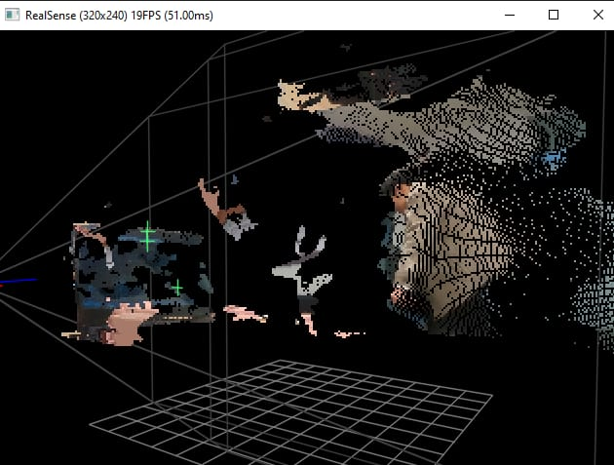
Image and Marker Representation on 3D Space
Notes:
Realsense function – deproject point to pixel – camera intrinsics, x,y pixel location, depth of point of interest

Slide 4
Plan for this week
Detect marker with the lens attached and calibrate camera.
Solve x and y axes position problem on 3D space.
Implement 3D space representation of Aruco marker pose.

Slide 5
7/11 – 11/11 Log
2022/11/07 (2pm — 5pm) Monday
Meeting with Kaizhong and Baoru.
Planning on task 2 and 3.
Discuss marker and RGBD image correspondence.
2022/11/08 (2pm — 5pm) Tuesday
Start working on representing image in 3D space.
Research references for Realsense’s colour and depth frame object.
Found problem on 3D representation (image shifted).
2022/11/10 (10am — 1pm) Thursday
Resolve error on shifted 3D representation.
Visualising marker as a green plus sign in 3D space.
Problem on the depth of the marker in 3D space, to be cont. the next day.
2022/11/11 (10am — 1pm) Friday
Resolve unmatched depth of the marker.
Code refactoring and structure naming changes.

